Slide 1


CHURN PREDICTION FOR
TELECOM COMPANY
Topic
Topic
Topic

Slide 2
INTRODUCTION
CHURN PREDICTION
is one of the most popular Big Data use cases in business.
It consists of detecting customers who
are likely to cancel a subscription to a service.
CHURN
is a problem for telecom companies because ,
it is more expensive to acquire a new customer than to keep your existing one from leaving.

Slide 3
REASON TO CHURN
SERVICE QUALITY
PRICE & PLANS
CUSTOMER SERVICE
RELOCATION

Slide 4

PROBLEM STATEMENT
We have collected a dataset where we’ve recorded some information about our customers: what type of services they used, how much they paid, and how long they stayed with us.
We also know who canceled their contracts and stopped using our services (churned).

Slide 5
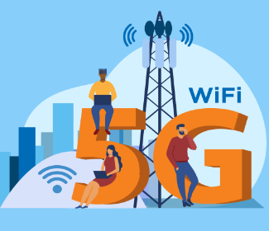
PROJECT OBJECTIVE
To predict Customer Churn.
Highlighting the main variables/factors influencing Customer Churn.
Use various ML algorithms to build prediction models, evaluate the accuracy and performance of these models.
Finding out the best model for our business case & providing executive summary.
Topic
Topic
Topic

Slide 6

DATASET DESCRIPTION
01
we will use Kaggle datasets for data. This time we will use
data from https://www.kaggle.com/blastchar/telco-customer-churn
According to the description, this dataset has the following information:
Services of the customers: phone; multiple lines; internet; tech support and extra services such as online security, backup, device protection, and TV streaming
Account information: how long they have been clients, type of contract, type of payment method
Charges: how much the client was charged in the past month and in total
Demographic information: gender, age, and whether they have dependents or a partner
Churn: Yes/no, whether the customer left the company within the past month

Slide 7
CHURN PREDICTION MODEL
DATA COLLECTION
TRAINING DATA
& TESTING DATA
DATA CLEANING
& PREPROCESSING
MODEL
SELECTION
.
FEATURE
ENGENEERING

Slide 8

METHODS
EDA(Exploratory Data Analysis)
EVALUATING ML ALGORITHM
Data Cleaning
Data Preprocessing
Logistic Regression
Decision Tree Classifier
Random Forest Classifier
SVC
Gradient Boosting
Naïve Bayes
Grid Search CV
Randomized Search CV.
FEATURE SELECTION
Select best
VISUALIZATION
Matplotlib.pyplot
Seaborn

Slide 9
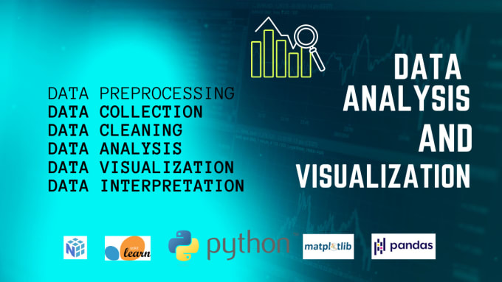
EDA

Slide 10
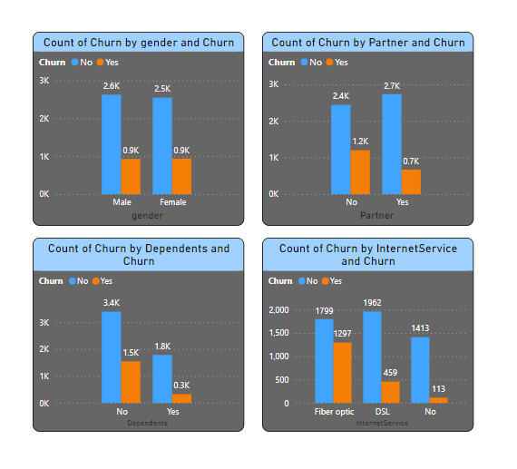
BAR GRAPH
The difference between the group rates for both females and males is quite small which doesn’t help us identify whether they will churn.
People with a partner churn less than people with no partner.
clients with no dependents are more likely to turn than the dependent clients
Senior citizens are more likely churn than nonseniors.
Internet service fiber optics users more likely to churn than others
Presentations are communication tools.

Slide 11
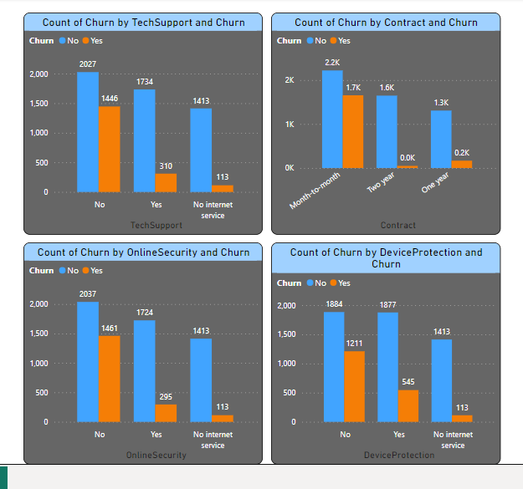
BAR GRAPH
Clients with no tech support are churn more than those who do
Clients with month-to-month contract are more likely to churn
Clients with no onlinesecurityt are churn more than those who do
Clients with no Deviceprotection are churn more than those who do
Topic
Topic
Topic

Slide 12
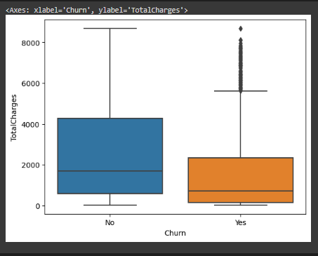
BOX PLOT
We found outliers in exiting customers which is out of whiskers. An Outlier is an observation that is numerically distant from the rest of the data.
Topic
Topic
Topic

Slide 13
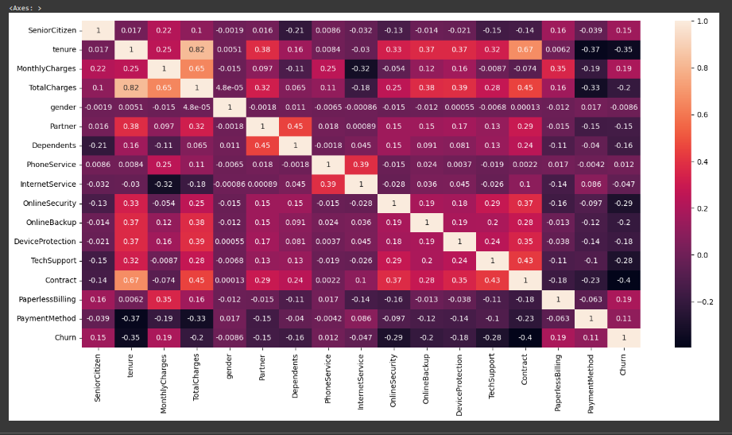
HEAT MAP
Your Title Here

Slide 14
UNDERSTANDING IMPORTANT VARIABLES
SeniorCitizen: whether the customer is a senior citizen (0/1)
OnlineSecurity: if online security is enabled (yes/no/no internet)
Tenure: number of months since the start of the contract.
OnlineBackup: if online backup service is enabled (yes/no/no internet).
MonthlyCharges: the amount charged monthly (numeric)
DeviceProtection: if the device protection service is enabled (yes/no/no internet)
TotalCharges: the total amount charged (numeric)
TechSupport: if the customer has tech support (yes/no/no internet)
Contract: the type of contract (monthly/yearly/two years)

Slide 15
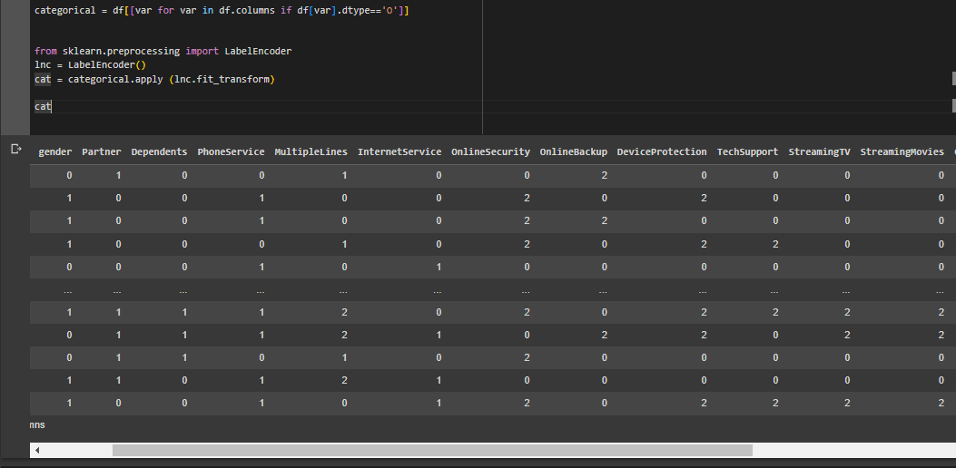
LABEL ENCODING
Now look at our target variable: churn. Currently, it’s categorical that’s why we use LABELENCODING.
LABELENCODING only applies to categoricals which is why we create categorical columns in 1 data frame.

Slide 16
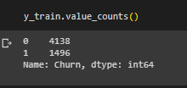
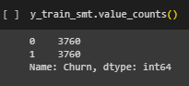
from sklearn.feature_selection import SelectKBest
from sklearn.feature_selection import chi2
k_best= SelectKBest(chi2,k=9) # for selecting 9 best features we use SelectKbest
k_best.fit(x,y)
ix = k_best.get_support()
dt = pd.DataFrame(k_best.transform(x),columns=x.columns.values[ix])
dt
FEATURE ENGINEERING
from sklearn.model_selection import train_test_split
x_train,x_test,y_train,y_test = train_test_split(x,y,test_size=0.2,random_state=42)
from imblearn.combine import SMOTETomek
smt = SMOTETomek(random_state=42)
x_train_smt,y_train_smt = smt.fit_resample(x_train,y_train)
from sklearn.preprocessing import RobustScaler
rs = RobustScaler()
x_train_sc = rs.fit_transform(x_train_smt)
x_test_sc = rs.fit_transform(x_test)

Slide 17
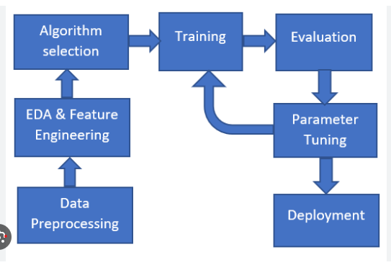
3
4
2
5
1
6
STEPS FOR MODEL BUILDING
PART

Slide 18
MODEL EVALUATION
from sklearn.linear_model import LogisticRegression
lrc = LogisticRegression()
lrc.fit(x_train_smt,y_train_smt)
from sklearn.model_selection import GridSearchCV
params = {'max_depth': [2, 3, 5, 10, 20],'min_samples_leaf': [5, 10, 20, 50, 100],'criterion': ["gini", "entropy"] }
grid_search = GridSearchCV(DecisionTreeClassifier(),param_grid=params,cv=5,
n_jobs=-1, verbose=1, scoring = "accuracy")
grid_search.fit(x_train_smt,y_train_smt)
from sklearn.tree import DecisionTreeClassifier
DT = DecisionTreeClassifier()
DT.fit(x_train_smt,y_train_smt)
from sklearn.ensemble import RandomForestClassifier
rfc = RandomForestClassifier()
rfc.fit(x_train_smt,y_train_smt)
from sklearn.model_selection import RandomizedSearchCV
n_estimators = [5,20,50,100]
max_features = ['auto', 'sqrt']
max_depth = [int(x) for x in np.linspace(10, 120, num = 12)]
min_samples_split = [2, 6, 10]
min_samples_leaf = [1, 3, 4]
bootstrap = [True, False]
random_grid = {'n_estimators': n_estimators, 'max_features':max_features,
'max_depth':max_depth,
'min_samples_split': min_samples_split,
'min_samples_leaf': min_samples_leaf,
'bootstrap': bootstrap}
random_search = RandomizedSearchCV(RandomForestClassifier(),param_distributions = random_grid,
n_iter = 100, cv = 5, verbose=2, random_state=35, n_jobs = -1)
random_search.fit(x_train_smt,y_train_smt)
from sklearn.svm import SVC
svm = SVC()
svm.fit(x_train_smt,y_train_smt)
from sklearn.naive_bayes import GaussianNB
NB = GaussianNB()
NB.fit(x_train_smt,y_train_smt)
from sklearn.ensemble import GradientBoostingClassifier
GB = GradientBoostingClassifier()
GB.fit(x_train_smt,y_train_smt)

Slide 19
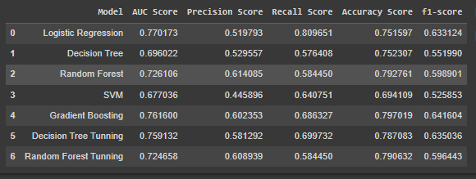
ACCURACY OF VARIOUS MODEL
Topic
Topic

Slide 20
HOW TO REDUCE CUSTOMER CHURN
Stay competitive
Lean into your best customers
Analyze churn when it happens.
Be proactive with communication.
Ask for feedback often.
Offer incentives.

Slide 21
FINDINGS AND SUGGESTIONS
BETTER SERVICE
FEEDBACK
CHANGES IN PLAN
PLAN SOLUTION
Try to offer better service for the churn customers, and see how much this impacts before and later. Some may use your service better move them to your active customers..
Take the feedback and suggestions within period of time and improve it, strive for better communication
When you are taking any change in plans of your business just predict the positive and negative share of that plan.
If the plan is negative prepare the solution before so You can handy easily..

Slide 22
CONCLUSION
The importance of this type of research in the telecom market is to help companies make more profit..
It has become known that predicting churn is one of the most important sources of income to Telecom companies
Hence, this research aimed to build a system that predicts the churn of customers in telecom companies.
.
These prediction models need to achieve high AUC values. To test and train the model, the sample data is divided into 70% for training and 30% for testing..

Slide 23
THANK
YOU
Topic
Topic
Topic

